Slide 1

Presentation On “Driver Alert System”
SUBMITTED TO: Mr. Rajneesh Pareek
SUBMITTED BY:
Team Name: Bachelors
Team Leader Name: Vishal Nath Chauhan
Notes:
1

Slide 2
Problem Statement
Idea/Solution
Objective of the project
Users of the project
Main components
Tools and Technologies
Screenshots
Conclusion

Slide 3
PROBLEM STATEMENT
Warning System for Driver Software
In order to ensure pedestrian safety and vehicle in areas with high pedestrian density/residential areas vehicles should run under a particular limit, so a system is needed to detect speed of vehicles and accordingly warn the driver about the speed limit for vehicles. The system needs to provide a warning to the driver, if the speed limits are breached.

Slide 4
IDEA/SOLUTION
Motivation
Reckless driving causes 33% of all the deaths involving major car accidents, which are more than 13,000 every year. 30% of the auto accidents are credited to the speed of reckless drivers.
Idea
Detecting speed limit of vehicles using CCTV camera and alert drivers accordingly on app when they breach speed limit.
Solution
Detecting vehicles who cross speed limit ,extracting number plate of the car and alert driver on app.

Slide 5
OBJECTIVE
To detect speed of all passing vehicles using CCTV and alerting the drivers on app by playing mp3 file.
USERS OF THE PROJECT
In present time we have system which will charge you on crossing speed limit,but our system will alert the drivers so that they can reduce speed.

Slide 6
Working
Detects the speed of every vehicle
Takes the picture of every vehicle exceeding
Extract the car number from the image
Search the car number in the app database
Alert the user

Slide 7
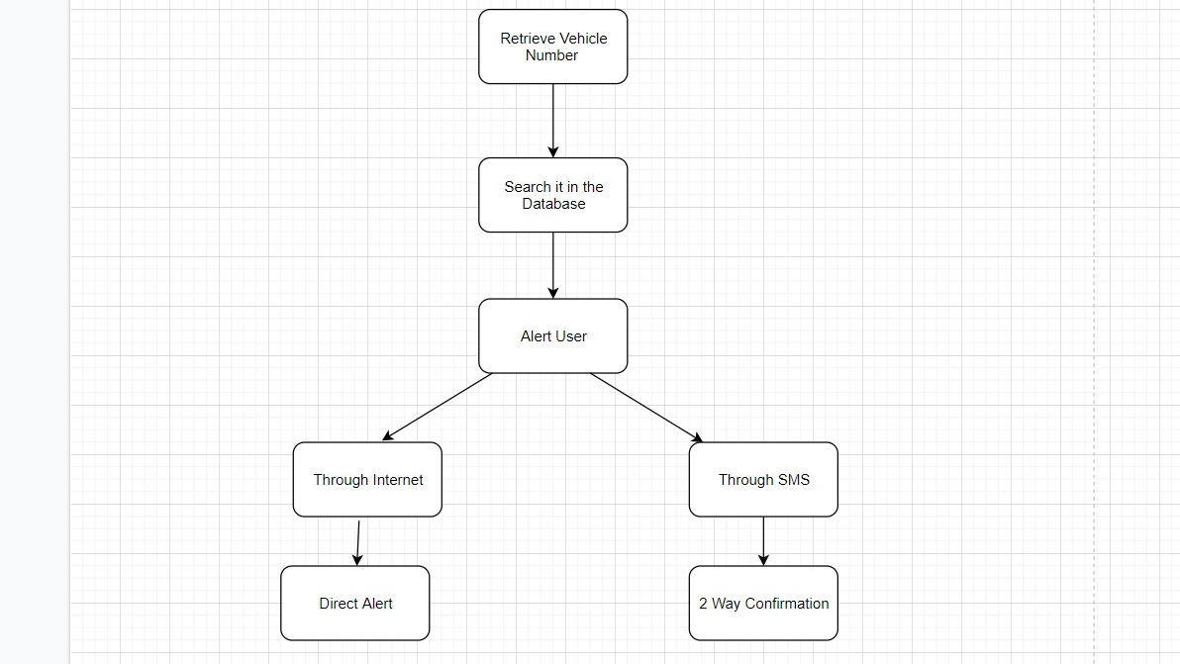
Diagram flow of Server

Slide 8
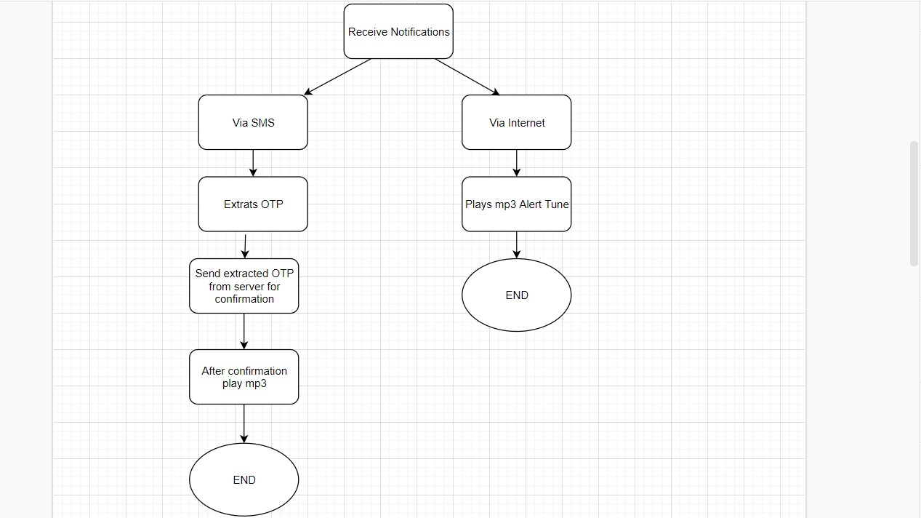
Work flow of app

Slide 9
Main components
CCTV footage
Server
Web app
Speed detection
Optimal character recognition
Verification system

Slide 10
TOOLS AND TECHNOLOGY
Programming Language : Python, html, css, javascript
Database : MySql
Libraries : Tensorflow, Keras, Flask, Numpy, Pandas, Matplotlib
Video Source : CCTV footage

Slide 11
CONCLUSION
Accidents are increasing day so we need a system to prevent overspeeding and reckless driving. We can extend this system to search stolen vehicles and inform to respective departments so that they can take appropriate actions against it.

